Slide 1


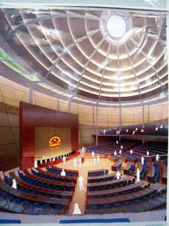
Chính phủ điện tử
TS. Phạm Văn Tính
Khoa CNTT, ĐH Nông Lâm TP.HCM
pvtinh@hcmuaf.edu.vn

Slide 2
Managed Beans
Classes to Represent Form Info

Slide 3
Outline
Basic beans and “managed” beans
Three parts of beans in JSF
Getter/setter methods to represent input elements
Action controller method
Placeholder for results (properties derived from input)
Prepopulating input fields
And building comboboxes (drop down menus)
Custom bean names
Bean scopes
Getting the “raw” request and response objects
Dependency injection

Slide 4
Basic Beans
Must have a zero-argument (empty) constructor
Should have no public instance variables (fields)
Persistent values should be accessed through methods called getBlah and setBlah
If class has method getTitle that returns a String, class is said to have a String property named title
JSF uses #{book.title} to mean “call getTitle on ‘book’ ”.
Boolean properties may use isBlah instead of getBlah

Slide 5
More on Bean Properties
Usual rule to turn method into property
Drop the word “get” or “set” and change the next letter to lowercase. Again, instance var name is irrelevant.
Method name: getFirstName
Property name: firstName
Example: #{customer.firstName}
Exception 1: boolean properties
If getter returns boolean or Boolean
Method name: getPrime or isPrime
Property name: prime
Example: #{myNumber.prime}
Exception 2: consecutive uppercase letters
If two uppercase letters in a row after “get” or “set”
Method name: getURL
Property name: URL (not uRL)
Example: #{webSite.URL}

Slide 6
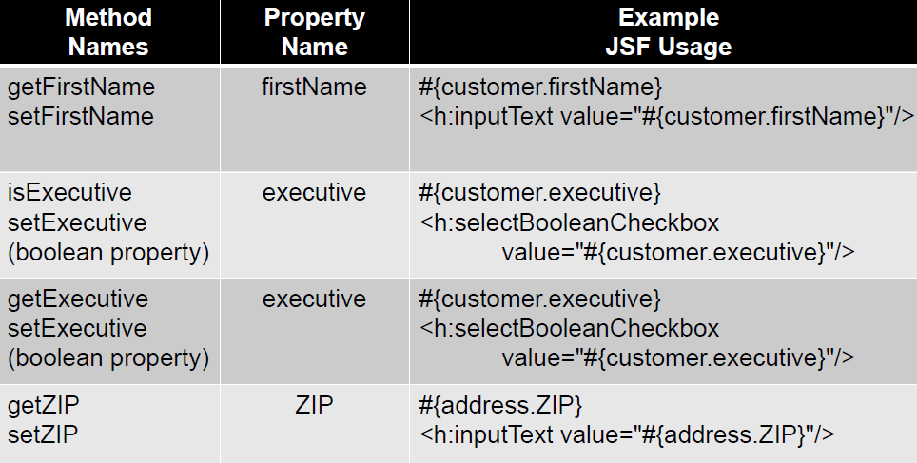
Bean Properties: Examples

Slide 7
Bean rules
To be a bean, you should use accessors, not public fields
Wrong
public double speed;
Right
private double speed; // Var name need not match method name
public double getSpeed() {
return(speed);
}
public void setSpeed(double speed) {
this.speed = speed;
}

Slide 8
The Three Parts of Managed Beans
Bean properties
One pair for each input element
Setter methods called automatically by JSF when form submitted. Called before action controller method.
Action controller methods
Often only one, but could be several if the same form has multiple buttons
Action controller method (corresponding to the button that was pressed) called automatically by JSF
Placeholders for results data
Not automatically called by JSF: to be filled in by action controller method based on results of business logic.
Needs a getter method so value can be output in results page, but not required to have a setter method.

Slide 9
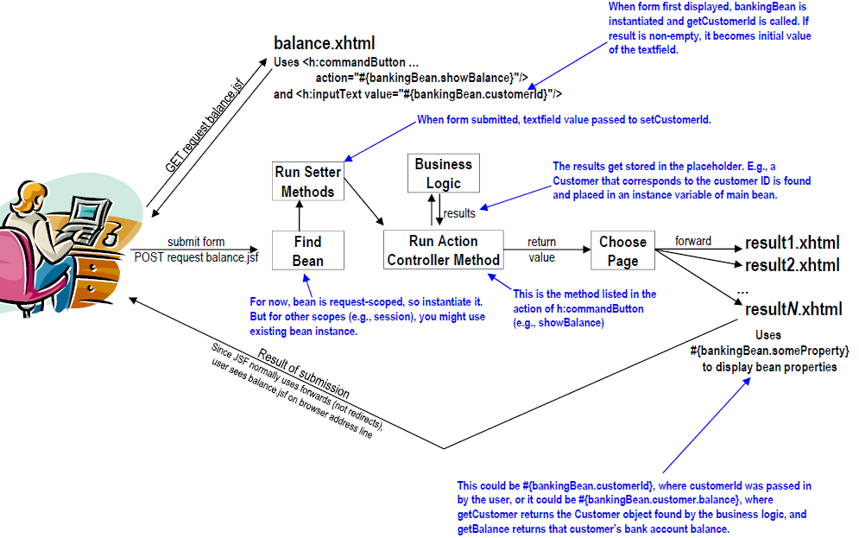
JSF Flow of Control

Slide 10
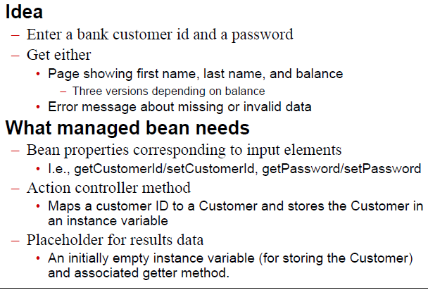
Example

Slide 11
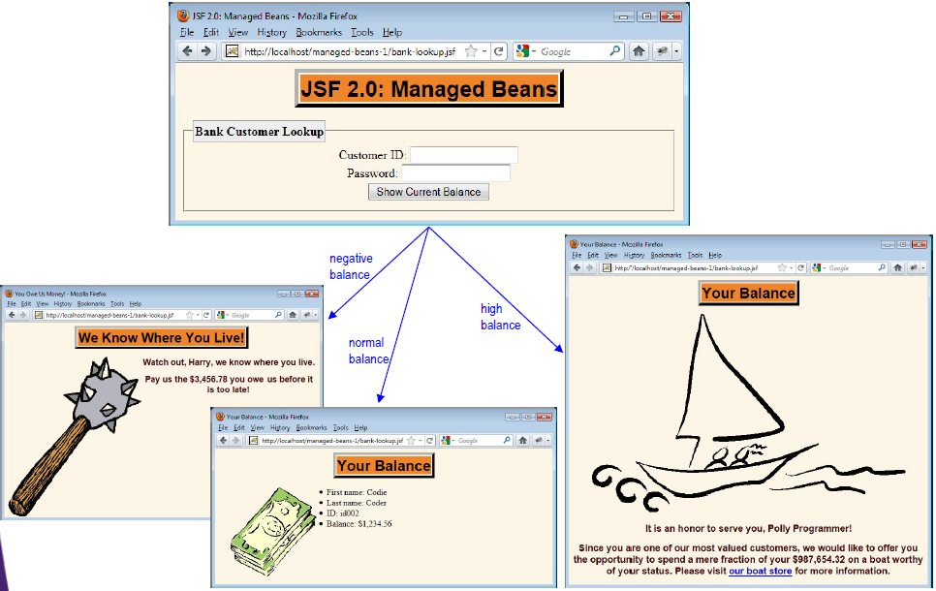
Results (Legal ID and Password)

Slide 12
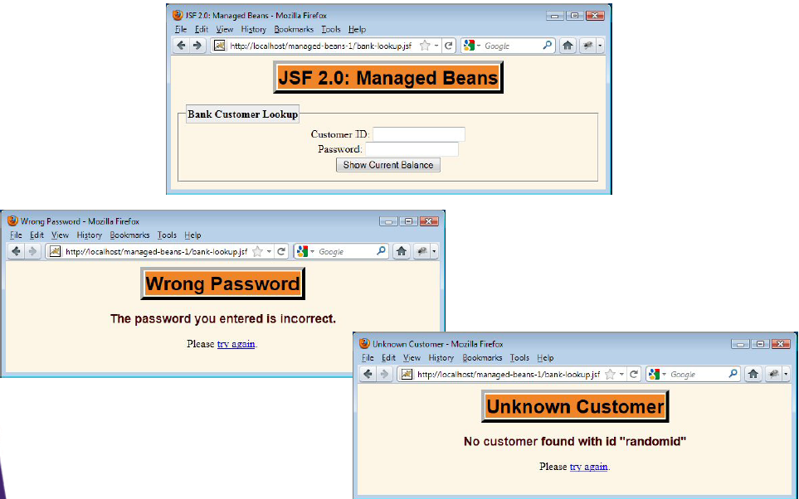
Results (Bad Inputs)

Slide 13
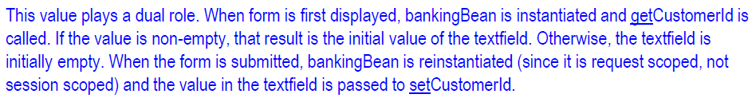
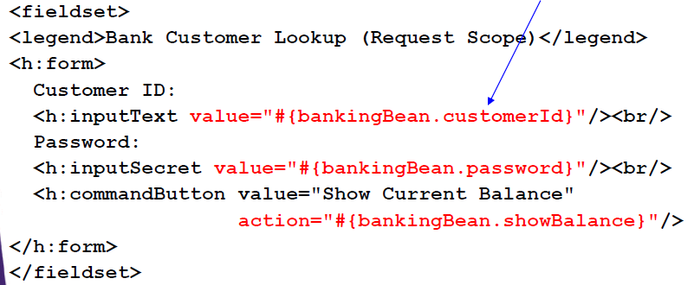
bank-lookup.xhtml

Slide 14
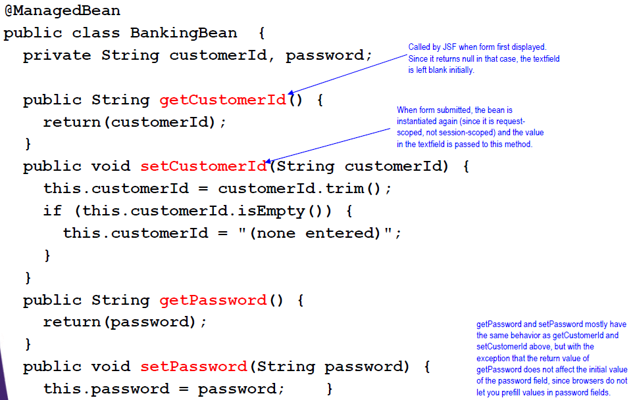

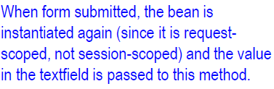
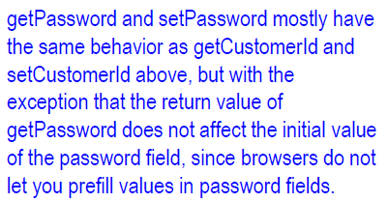
BankingBean.java Properties for Input Elements

Slide 15
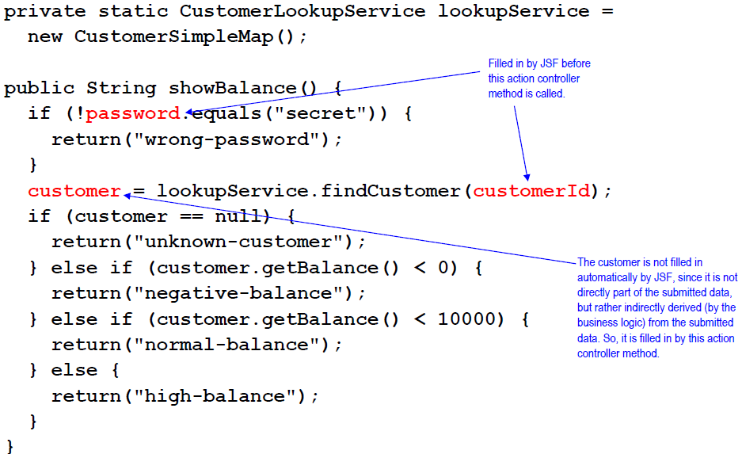

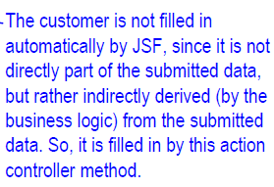
BankingBean.java Action Controller Method

Slide 16
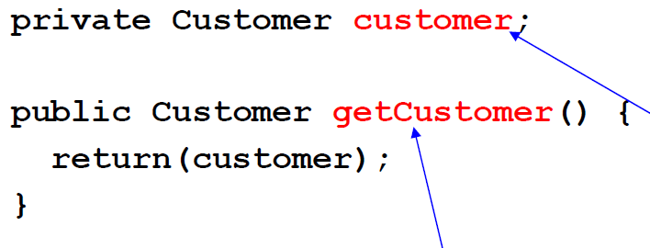
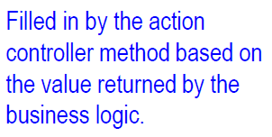
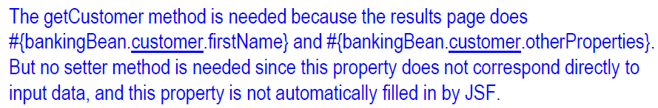
BankingBean.java (Placeholder for Results)

Slide 17
Business Logic
public interface CustomerLookupService {
public Customer findCustomer(String id);
}
public class CustomerSimpleMap
implements CustomerLookupService {
private Map<String,Customer> customers;
public CustomerSimpleMap() {
customers = new HashMap<String,Customer>();
addCustomer(new Customer("id001", "Harry",
"Hacker", -3456.78));
addCustomer(new Customer("id002", "Codie",
"Coder", 1234.56));
addCustomer(new Customer("id003", "Polly",
"Programmer", 987654.32));
}

Slide 18
Business Logic
public Customer findCustomer(String id) {
if (id != null) {
return(customers.get(id.toLowerCase()));
} else {
return(null);
}
}
private void addCustomer(Customer customer) {
customers.put(customer.getId(), customer);
}
}

Slide 19
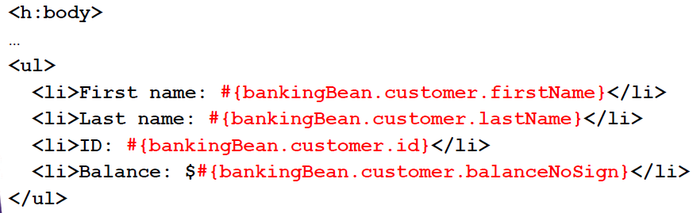
Results Pages: Good Input (normal-balance.xhtml)

Slide 20
Results Pages: Bad Input (unknown-customer.xhtml)

Slide 21
Prepopulating Input Fields
Bean property refers to both getter & setter
The getter method is called when form is displayed, and affects what is initially displayed to user
The value from the input element is passed to the setter method when the form is submitted
Examples
<h:inputText…/> (textfield) If getter returns non-empty (neither null nor ""), this is initial value inside textfield. Not used for password fields.
<h:selectBooleanCheckbox…/> (checkbox) Getter returns true: initially checked. Otherwise unchecked
<h:selectOneMenu…/> (combobox; drop down menu) If return value of getter matches an entry in menu, that is initial selection. Otherwise top entry is initially selected.

Slide 22
Textfields
Example 1 (Simple property)
<h:inputText value="#{someBean.someProperty}"/> • When form initially displayed, call getSomeProperty. If value is something other than null or empty String, use it as initial value of textfield.
• When form submitted, take the value in the textfield and pass it to setSomeProperty.
Example 2 (Chained properties)
<h:inputText value="#{someBean.a.b.c}"/> • When form initially displayed, call getA, then getB on that result, then getC on that. If value of getC is non-empty, use it as initial value of textfield. • When form submitted, call getA, then getB on that result. Then take the value in the textfield and pass it to the setC method of that final result. Only last one becomes setter.

Slide 23
Checkboxes
<h:selectBooleanCheckbox value="#{someBean.someProperty}"/>
When form initially displayed, call the accessor method, which must be of type boolean or Boolean. The name could be either isSomeProperty (most common) or getSomeProperty. If value is true, make checkbox initially checked. If value is false, make checkbox initially unchecked.
When form submitted, pass either true or false to setSomeProperty (which expects boolean or Boolean)

Slide 24
Drop Down Menus (Comboboxes)
<h:selectOneMenu value="#{someBean.someProperty}">
<f:selectItems value="#{someBean.choices}"/>
</h:selectOneMenu>
When form initially displayed, call getChoices (which should return List<SelectItem> or SelectItem[]). This gives the entries in the drop down menu. Then call getSomeProperty. If result matches any of the entries, make that initially shown item. Otherwise use top item.
There are several forms of the SelectItem constructor, but the simplest just takes a String: the value that will go in the menu.
When form submitted, pass the current selection to setSomeProperty.

Slide 25
Example
Idea
Collect input about programming background and preferences. Give recommended computer study plan.
Input form
Textfield for favorite language. Prepopulate based on most popular language in the application
Drop down menu for second-favorite language. Make choices be the languages for which app has study guides. Make initial choice the second most popular language in the application.
Two checkboxes. Initial selection based on logic in app
Results page
List of recommended languages. Requires looping tag.

Slide 26
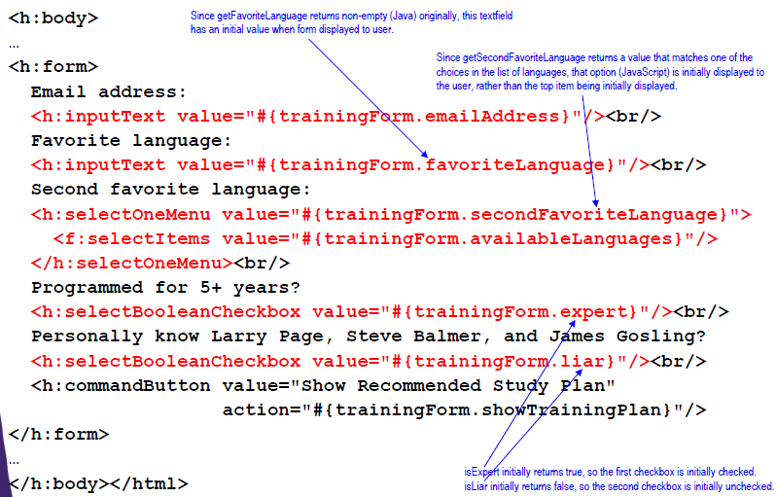
Input Form – Bottom (study-plan-input.xhtml)

Slide 27
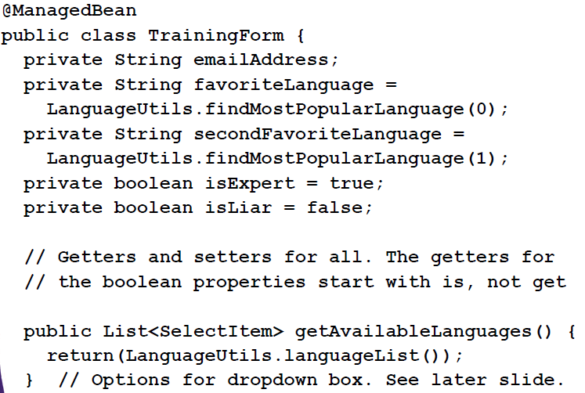
Managed Bean (Part 1 – Properties for Input Elements)

Slide 28
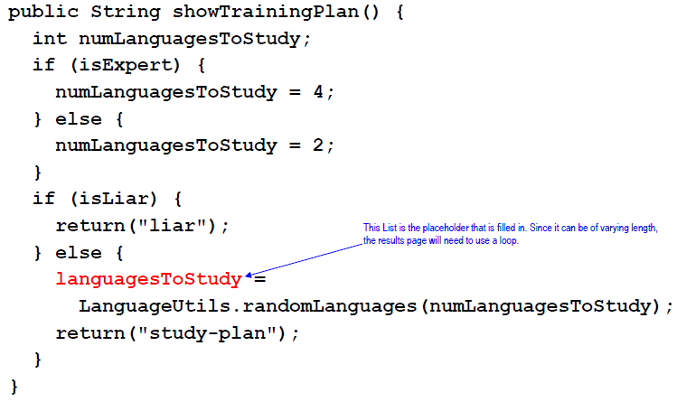
Managed Bean (Part 2 – Action Controller)

Slide 29
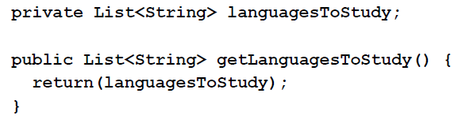
Managed Bean (Part 3 – Placeholder for Results)

Slide 30
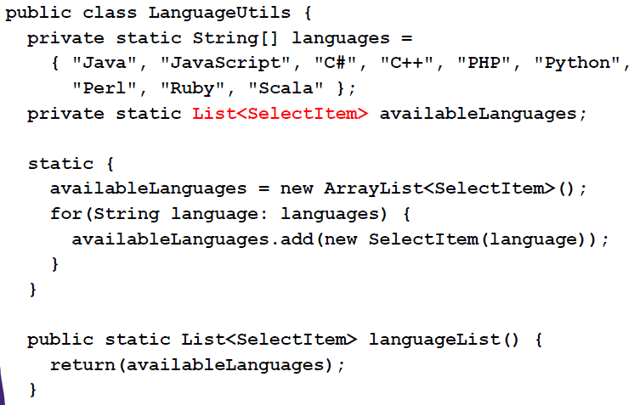
Helper Class (Code for Options in Dropdown)

Slide 31
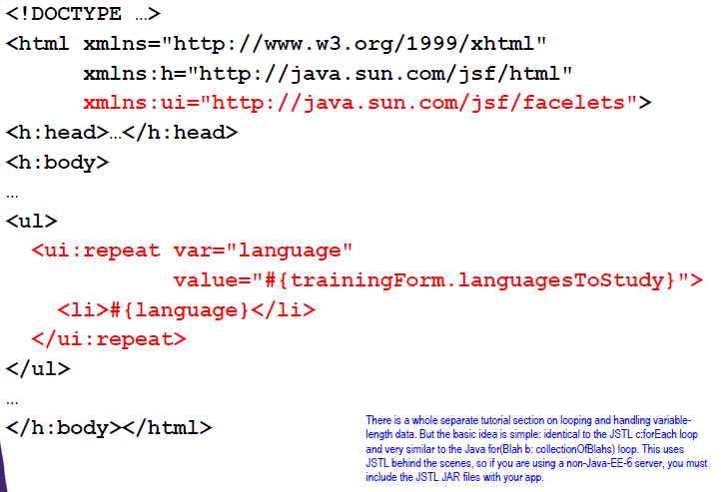
Main Results Page (study-plan.xhtml)

Slide 32
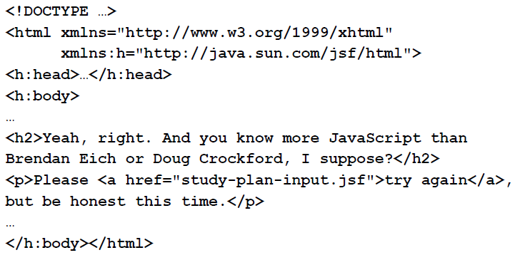
“Error” Page (liar.xhtml)

Slide 33
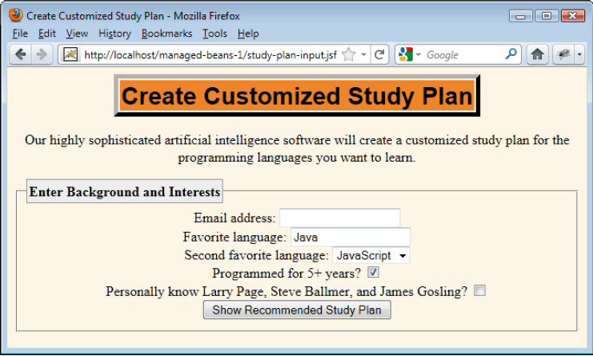
Results (Input Form)

Slide 34
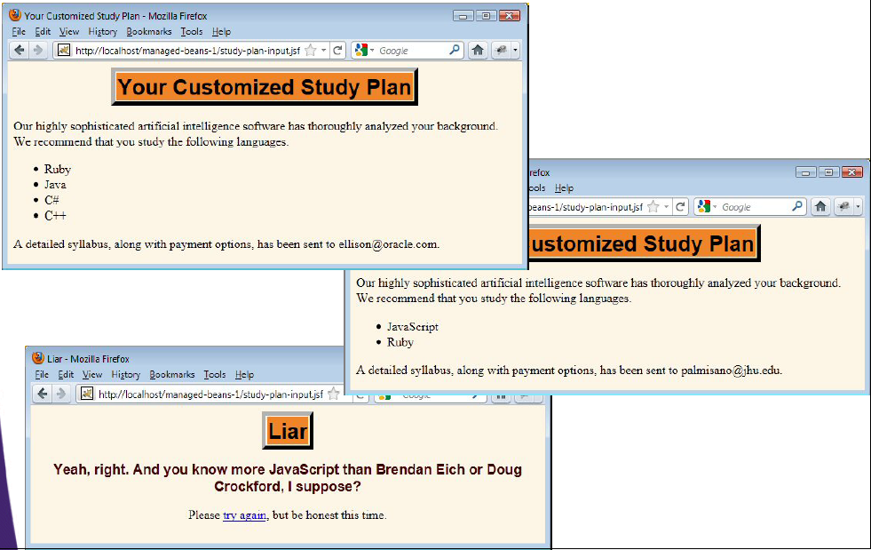
Results (Results Pages)

Slide 35
Custom bean names
The name attribute of @ManagedBean
@ManagedBean(name="anyName")
public class BeanName { … }
You refer to bean with #{anyName.blah}, where bean name is exact value of name attribute.
Still request scoped by default.
Still no entries in faces-config.xml

Slide 36
Bean Scopes
Idea
Designates how long managed beans will stay “alive”, and which users and requests can access previous bean instances.
JSF 1.x scopes
Request, session, application
Specified in faces-config.xml
Request scope is the default
JSF 2.0 scopes
request, session, application, view, none, custom
Specified either in faces-config.xml or by one of the new annotations (e.g., @SessionScoped)
Request scope is still the default

Slide 37
Annotations to Specify Bean Scope
@RequestScoped
Default. Make a new instance for every HTTP request. Since beans are also used for initial values in input form, this means bean is generally instantiated twice (once when form is displayed, once when form is submitted).
@SessionScoped
Put bean in session scope. If same user with same cookie returns before session timeout, same bean instance is used. You should make bean Serializable.
@ApplicationScoped
Put bean in application scope. Shared by all users. Bean either should have no mutable state or you must carefully synchronize access.

Slide 38
Annotations to Specify Bean Scope
@ViewScoped
Same bean instance is used as long as same user is on same page (e.g., with event handlers or Ajax).
New scope in JSF 2.0.
Bean should implement Serializable
@CustomScoped(value="#{someMap}")
Bean is stored in the Map, and programmer can control lifecycle.
New scope in JSF 2.0
@NoneScoped
Bean is not placed in a scope. Useful for beans that are referenced by other beans that are in scopes.
New scope in JSF 2.0

Slide 39
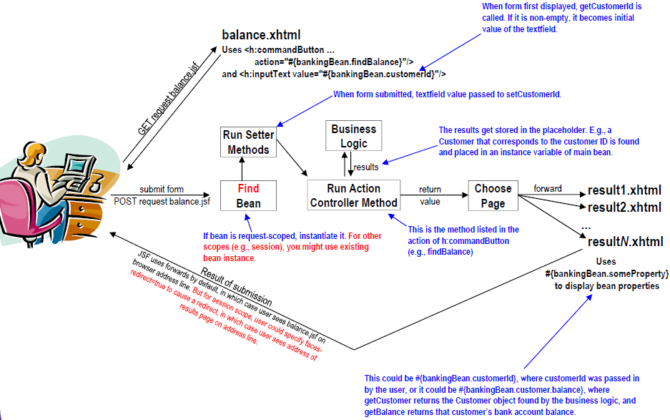
Simple JSF Flow of Control

Slide 40
use annotations to give scope
You can use annotations to give scope
@RequestScoped (same as omitting scope)
@SessionScoped
@ApplicationScoped
@ViewScoped
@CustomScoped
@NoneScoped
Traditionally placed after @ManagedBean
@ManagedBean
@SessionScoped
public class SomePojo { … }

Slide 41
Application Scope
Shared across all users and all pages
For beans that have no changeable state
Supplies list of choices for drop down menus
<h:selectOneMenu value="#{requestScopedBean.choice}">
<f:selectItems value="#{appScopedBean.options}"/>
</h:selectOneMenu>

Slide 42
Application Scope: Syntax
@ManagedBean
@ApplicationScoped
public class SomeClassNoUserState { … }
Class is instantiated first time it is used. After that, all users and all requests share the same instance.

Slide 43
Application Scope: Syntax
Eager Application-scoped Beans Managed beans are lazily instantiated. That is, that they are instantiated when a request is made from the application. To force an application-scoped bean to be instantiated and placed in the application scope as soon as the application is started and before any request is made, the eager attribute of the managed bean should be set to true as shown in the following example
@ManagedBean(eager=true)
@ApplicationScoped
public class SomeClassBigDataNoUserState { … }
Class is instantiated when the app is loaded (which is usually when the server starts). After that, all users and all requests share the same instance. Useful if the class has a big data structure that takes a long time to initialize.

Slide 44
Session Scope
Bean instance reused if
Same user
Same browser session Usually based on cookies, but can be based on URL rewriting
Useful for
Remembering user preferences
Prefilling values from previous entries
Accumulating lists of user data (ala shopping carts)
Normal Java session tracking rules apply
Custom classes should be Serializable
Some servers save session data to disk on restart
Distributed Web apps need this to replicate sessions

Slide 45
Session Scope: Example
Idea
Small variation of banking example
Remember previously entered id • If end user comes back to input page, the ID they entered last time is already filled in
What you need
Add @SessionScoped for bean
Make bean Serializable
Optionally, add faces-redirect=true to end of return values, to tell JSF to redirect (instead of forward) to results pages • Allows users to access results pages directly

Slide 46
Page Forward Vs Page Redirect
By default, JSF will performs a server page forward while navigating to another page. See following example to differentiate between page forward and page redirect.
A “start.xhtml” page, with a button navigate to “page1.xhtml” page.

Slide 47
1. Page Forward
Browser send a “GET” request to URL : http://localhost:8080/JavaServerFaces/faces/start.xhtml
JSF received the request and return the “start.xhtml“.
Browser display the content of “start.xhtml“.
User click on the button.
JSF received the action and perform an internal page forward to “page1.xhtml” in the server side.
JSF return the “page1.xhtml“.
Browser display the content of the “page1.xhtml“.
In the page forward, browser’s URL is not update.

Slide 48
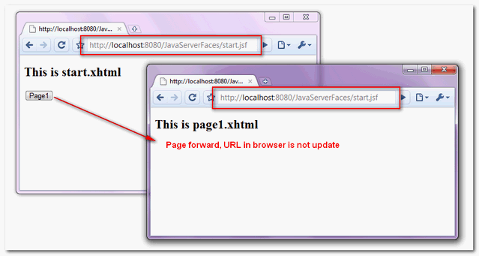
1. Page Forward

Slide 49
2. Page Redirection
Browser send a “GET” request to URL : http://localhost:8080/JavaServerFaces/faces/start.xhtml.
JSF received the request and return the “start.xhtml“.
Browser display the content of “start.xhtml“.
User click on the button.
JSF received the action and send back a “redirect” to “page1.xhtml” response back to the browser.
Browser received the response and send another “GET” request to URL : http://localhost:8080/JavaServerFaces/faces/page1.xhtml.
JSF received the request and return the “page1.xhtml“.
Browser display the content of the “page1.xhtml“, and the browser’s URL is updated.

Slide 50
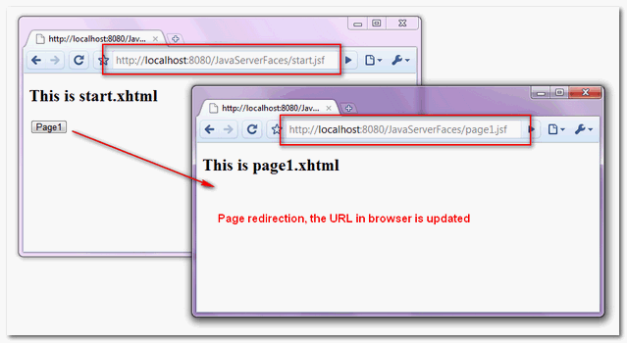
2. Page Redirection

Slide 51
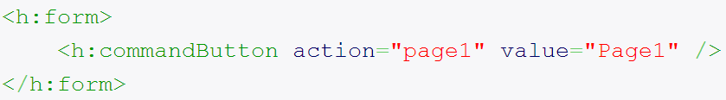
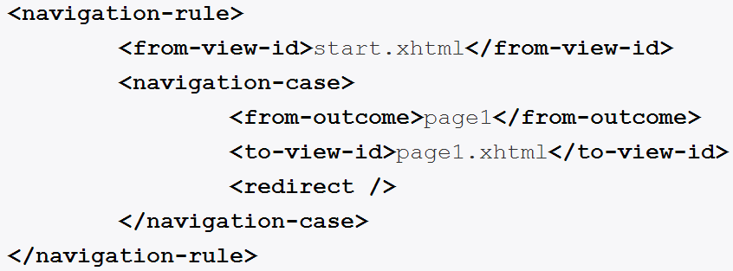
enable the page redirection
To enable the page redirection in JSF 2.0, you can append “?faces-redirect=true” at the end of the outcome string

Slide 52
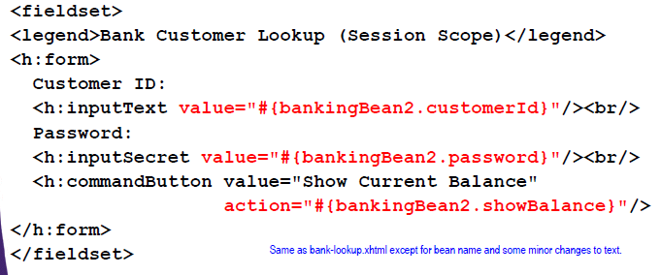
bank-lookup2.xhtml

Slide 53
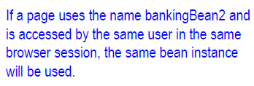
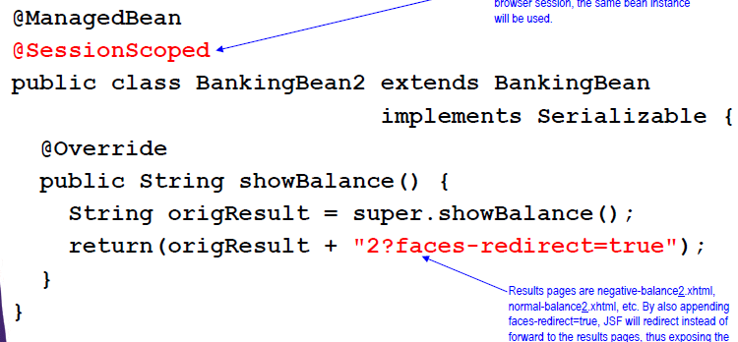
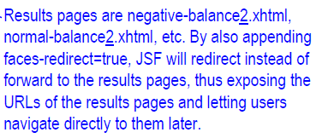
BankingBean2.java

Slide 54
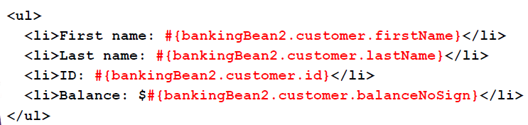
normal-balance2.xhtml

Slide 55

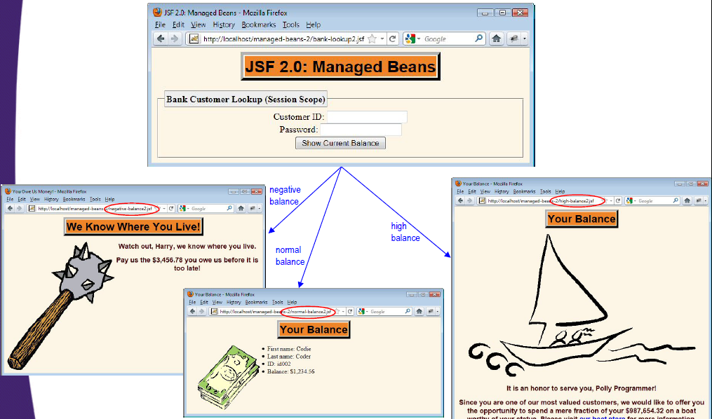
Results (Initial Access)

Slide 56
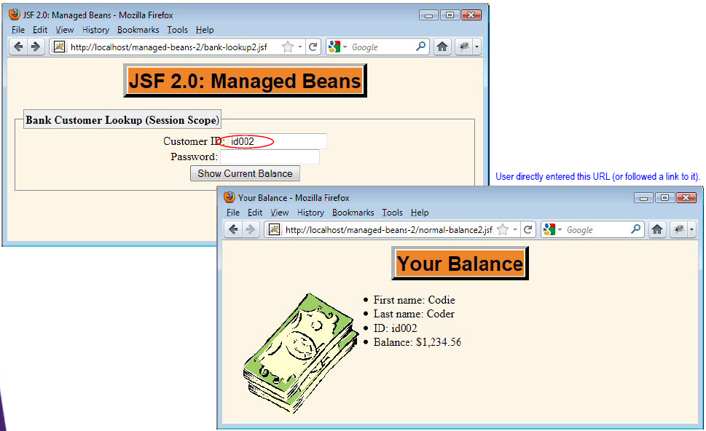
Results (User Returns in Same Browser Session)

